Slide 1
Coors problem framing
- Amita K

Slide 2
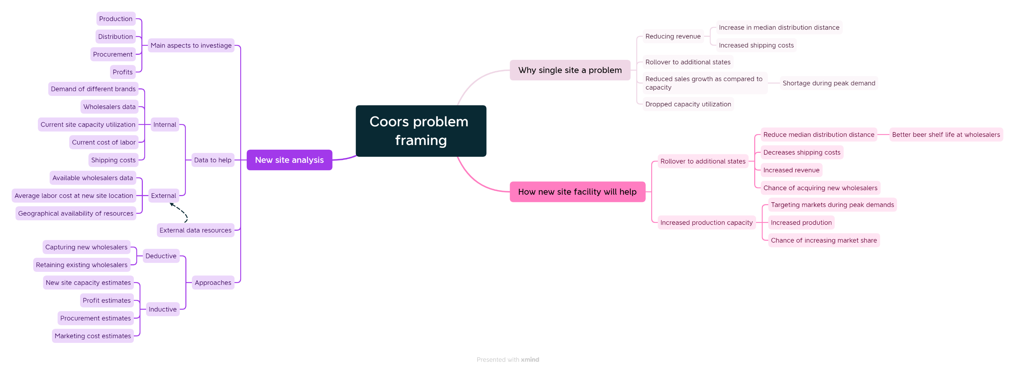
Problem framing

Slide 3
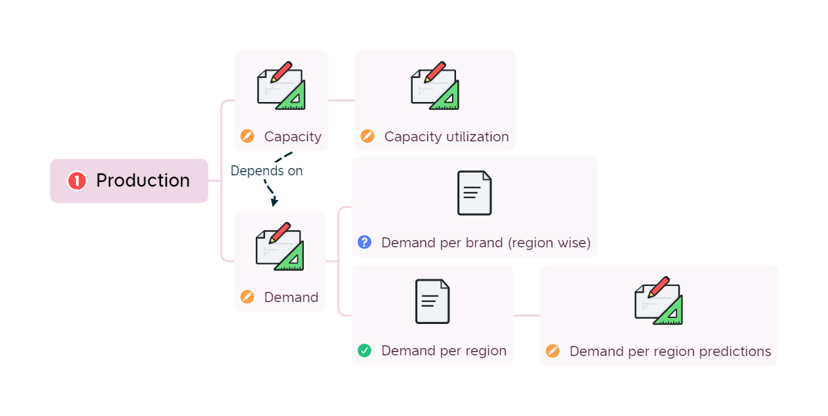
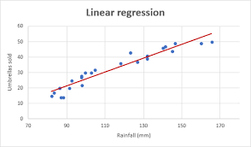






Production
Estimate the required capacity of the site based on the demand and demand predictions.
Note: Consider the different capacity utilizations in order to predict the production. Keep some space for unutilized capacity in the initial period.
Collect the capacity utilization data YoY to understand how much capacity is used for the existing site.
Collect data about demand per brand region wise.
We can also plot a regression graph to predict the near future demands.
Estimation required
Additional data required
Data available
Internal data
External data
Estimate the numbers
Notes:
We need to estimate the capacity required for the production. This can be estimated based on the following:
Estimate the demand for different brands → Based on the region wise demand per brand, demand predictions in near future
Estimate the capacity → Based on the predicted demands
Note: This includes brand wise predictions
Estimate the capacity utilization → Based on the capacity utilization at the current site
Note: Please keep some room for the lower capacity utilization in the initial phases of the site.

Slide 4
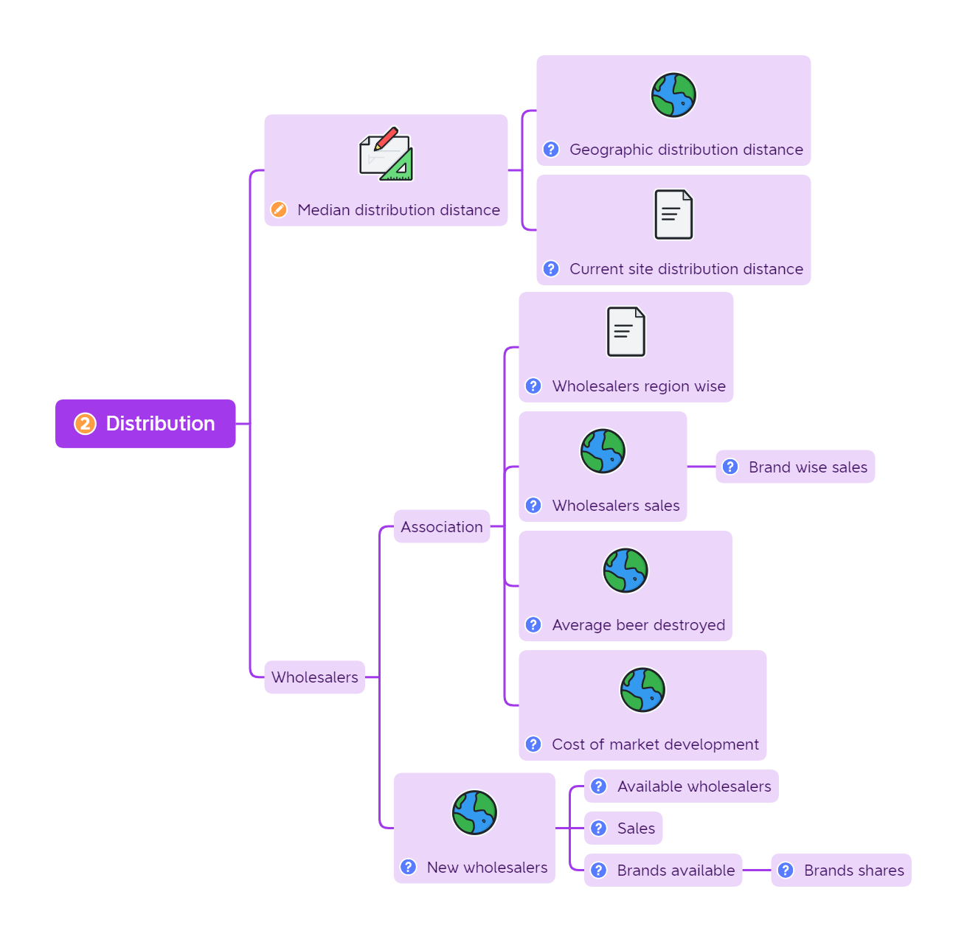
Distribution
Collect the data about geographical distances from the new manufacturing sites to the existing wholesalers, to calculate the median distribution distance.
Note: The distributions should be divided in the two regions, based on 2 sites locations.
Collect data about associated wholesalers to analyze their trends, which will help in running the experiments.
Estimation required
Run experiments to understand if new wholesalers can be added by
Absorbing the market development cost partially
Absorbing costs of expired beers
Providing beer pricing liberty partially
Additional data required
Data available
Internal data
External data
Estimate the numbers
Notes:
We need to understand the distribution impact based on the following:
Estimate the median distribution distance → Based on the Geographical distribution distance from the new site, and current site distribution distance
Note: Divide the distribution between the 2 sites when estimating the median distance.
Gather data about the current wholesalers association, so that the strategy to include the new wholesalers near the new site and the regions can be worked on.
Currently associated wholesalers region wise, their shares
Sales at the wholesalers, brand wise sales
Average beer destroyed at the wholesalers
Cost of market development
Collect the external data about the available wholesalers:
Available wholesalers
Their sales
Brands sold by them
Based on these details, some experiments can be run to capture the new wholesalers. These experiments can be performed even with respect to the current site productions.

Slide 5
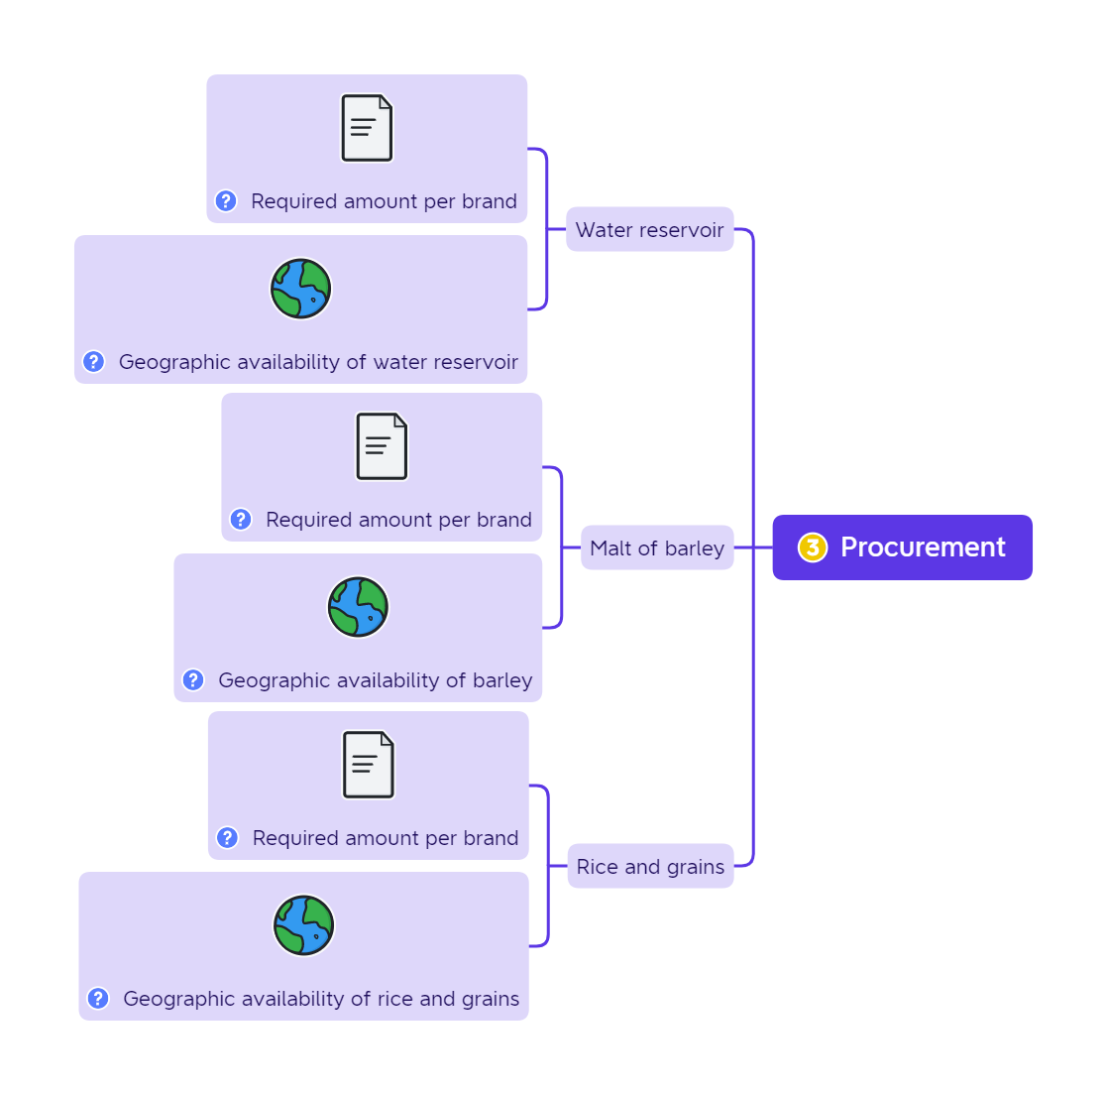
Procurement
Estimate the required amount of all these resources based on the following data analyzed / collected earlier:
Demand for each brand
Brand wise resources required
Beer wastage due to expiry
Estimation required
Additional data required
Based on the required amount of resources, collect the external data about the availability of those resources in the near vicinity of the site. Note: Multiple resources can be considered to cater to the site requirements.
Data available
Internal data
External data
Estimate the numbers
Notes:
Collect the following data in order to understand the resources for procurement:
Required amount of water per brand → Based on the capacity estimates
Geographical availability of water reservoir in vicinity
Required amount of barley → based on the capacity estimates
Geographical availability of barley in vicinity
Required amount of rice and grains → Based on the capacity estimates
Geographical availability of rice and gran in vicinity

Slide 6
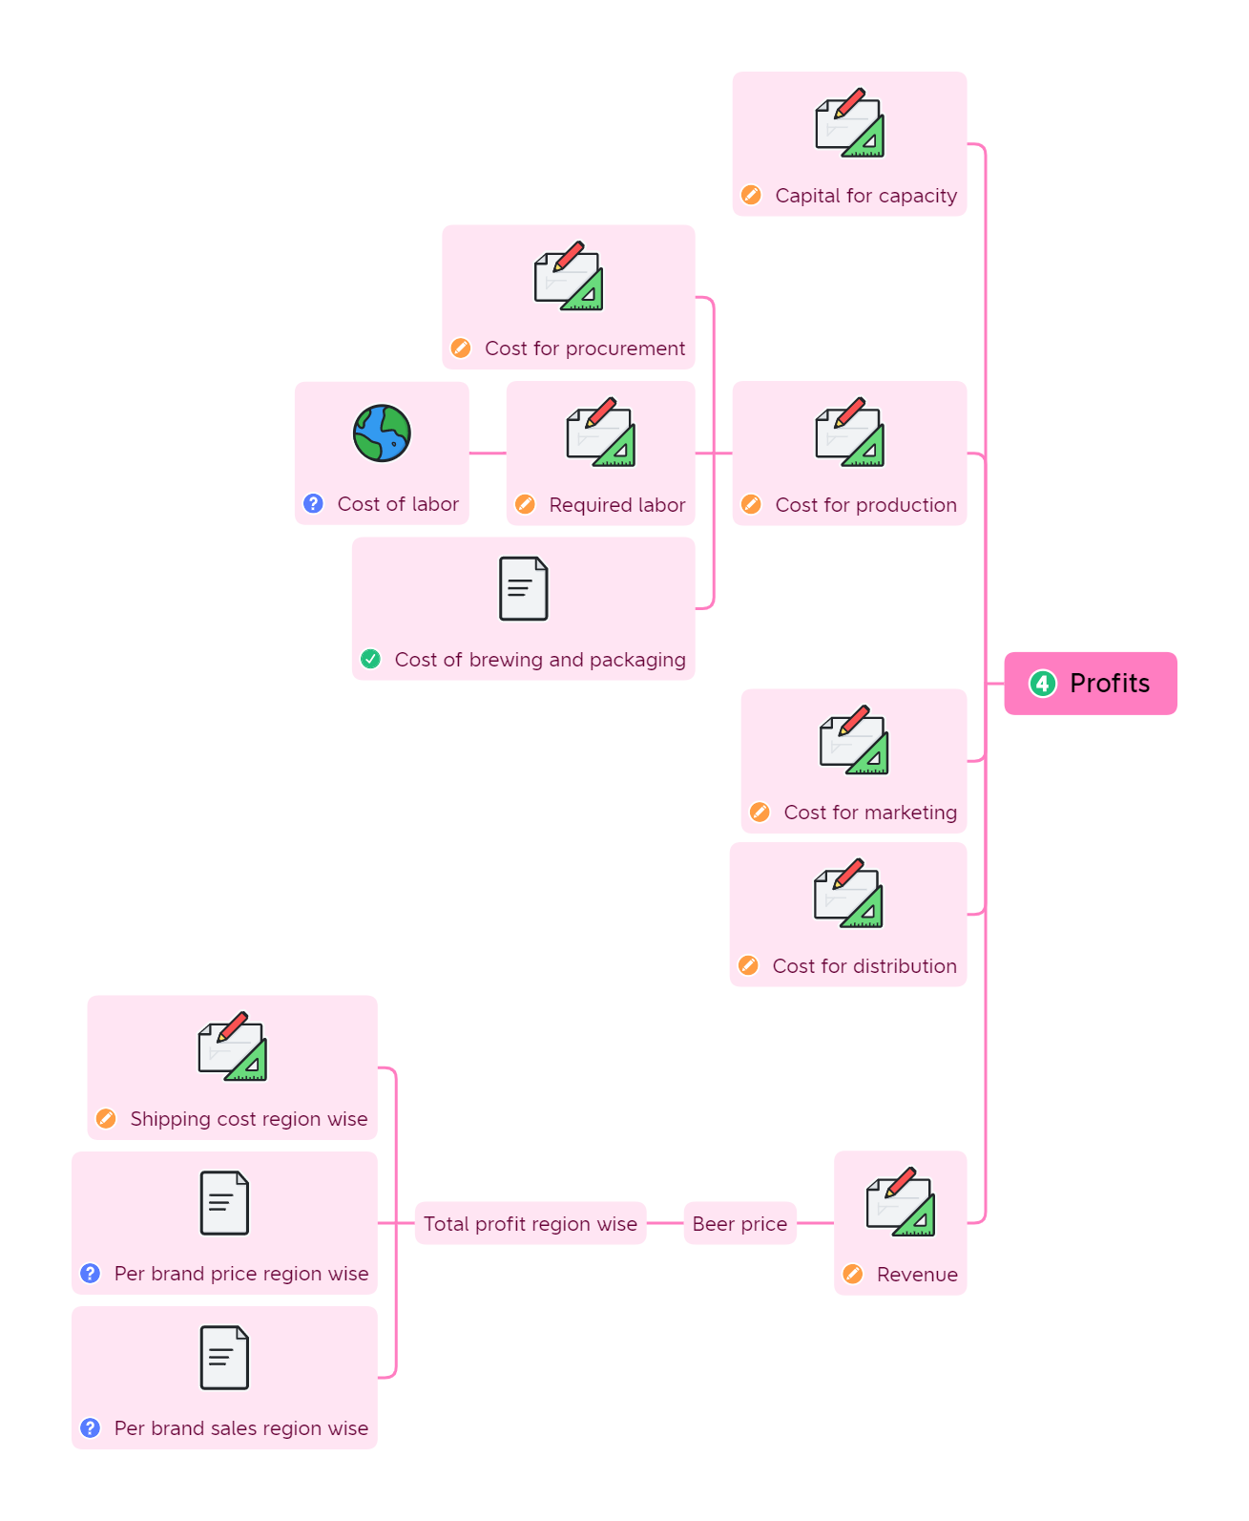
Profits
Collect the external data about the labor cost for the region of the site. And then estimate the labor cost based on the following:
Required labor based on the required production
Average labor cost in the region
Collect the following internal data to estimate the revenue:
Region wise price per brand
Region wise sales per brand
Estimation required
Additional data required
Data available
Internal data
External data
Estimate the numbers
Notes:
In order to estimate the profits and initial capital required, we need to do the following:
Estimate the capital required for capacity → Based on the required capacity and capacity utilization estimated earlier. Inductive approach to be used by studying the current site capital investments.
Estimate the cost of production → Based on the cost of procurement (estimated earlier), cost of labor (Estimated based on labor requirements) and cost of production (Estimated based on production requirements)
Estimate the cost of marketing → Based on the advertising data available
Estimate the cost of distribution → Based on the median distribution distance (Calculated earlier) and shipping costs (Estimated based on the distance and current shipping cost data)
Estimate the total profits → Based on the revenue (Estimated based on per brand price and per brand sales region wise) and the total production (Estimated earlier) and distribution costs involved (Estimated earlier)

Slide 7
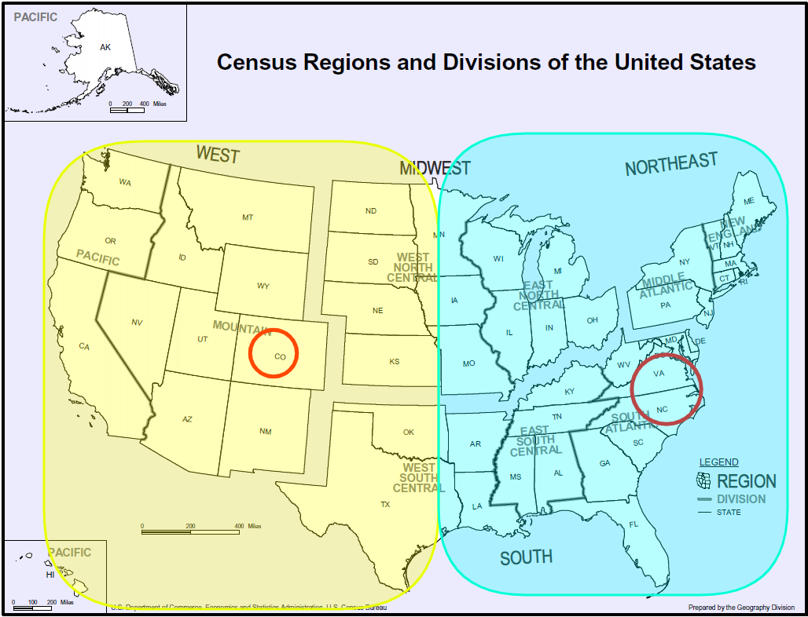
Capacity estimations | Analysis details
New England region
Year | Coors Banquet | Coors Light
1977 | 6.1 | 2.0
1978 | 5.5 | 2.5
1979 | 6.7 | 4.2
1980 | 5.2 | 5.1
1981 | 4.0 | 6.1
1995 | ? | ?
Predict the demand for the regions under blue color, which will be catered to by the second site. The summation of all these will be the required capacity of the new site.

